Slide 1

Factors Influencing ACT Scores
Meral Balik
January 30, 2020

Slide 2
Contents
Problem Statement
Dataset
Data Wrangling
Exploratory and Statistical Data Analysis
Machine Learning Analysis
Unsupervised Learning
Supervised Learning

Slide 3
ACT Test
Assess high school students' general educational development
Also used to compare schools and districts
Four subject areas: English, mathematics, reading, and science
Score ranges from 1 to 36

Slide 4
Dataset
ACT Data
https://www.cde.ca.gov/
High schools in California
School code, school name,
County name, district name
Number of students in grade twelve,
Average English, math, reading and science scores
Census Data
https://www.greatschools.org/
ID number, Longitude, latitude,
City, county, number of students enrolled,
Percentage of different ethnic backgrounds
Percentage of low-income students who have the right to receive reduced priced meal

Slide 5

Data Wrangling
Data Acquisition and Merging
ACT Data Specifics
Cleaned extra white spaces from column names and text
Removed rows with many missing values
Concatenated files from 2014 to 2018 into one
Census Data Specifics
Removed the school names causing duplicates
Acquired two API calls
Concatenated two files into one
Used fuzzy wuzzy library to match school names
Merged two data sets on school and county name

Slide 6
Exploratory and Statistical Data Analysis

Slide 7
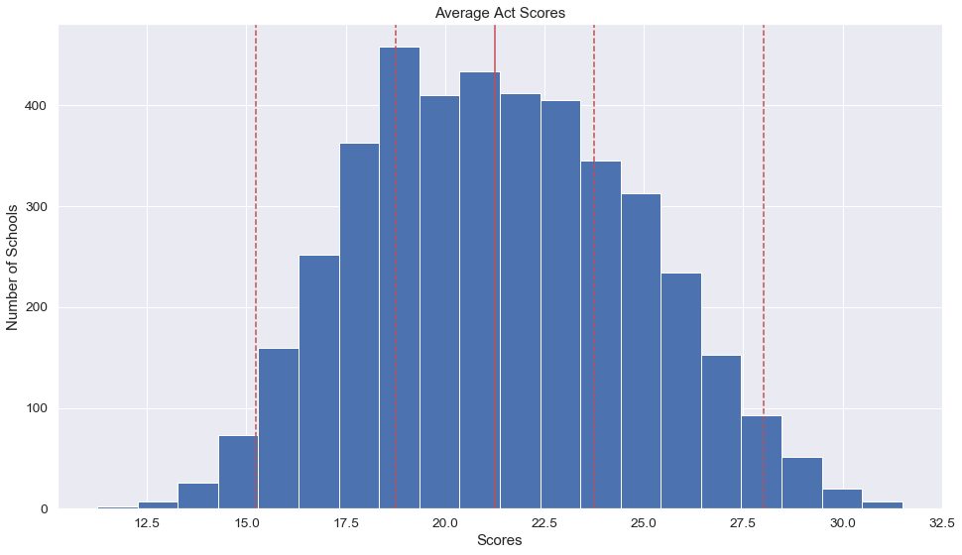
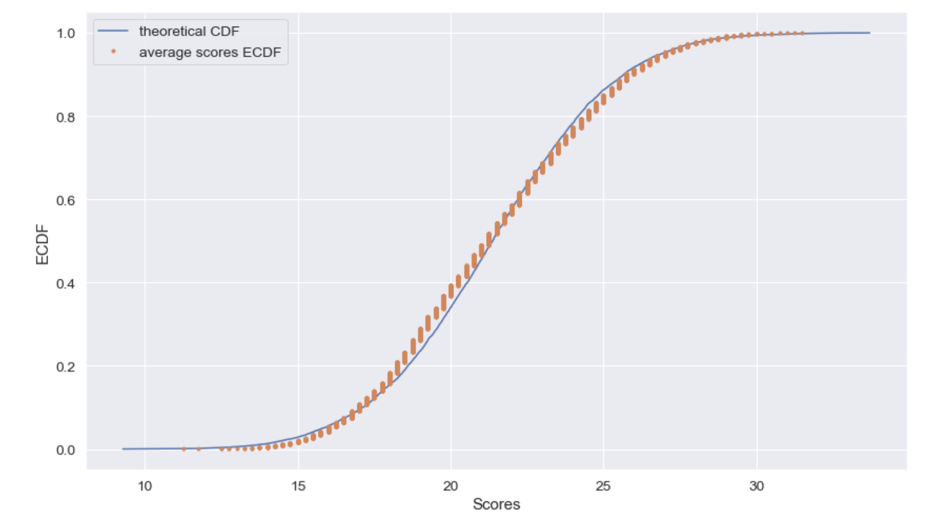

What is the distribution of the ACT scores?
Scores are normally distributed, coincides with theoretical cumulative distribution function
Corresponding values for the 2.5, 25, 50, 75, 97.5 percentiles are: 15.25 18.75 21.25 23.75 28.

Slide 8
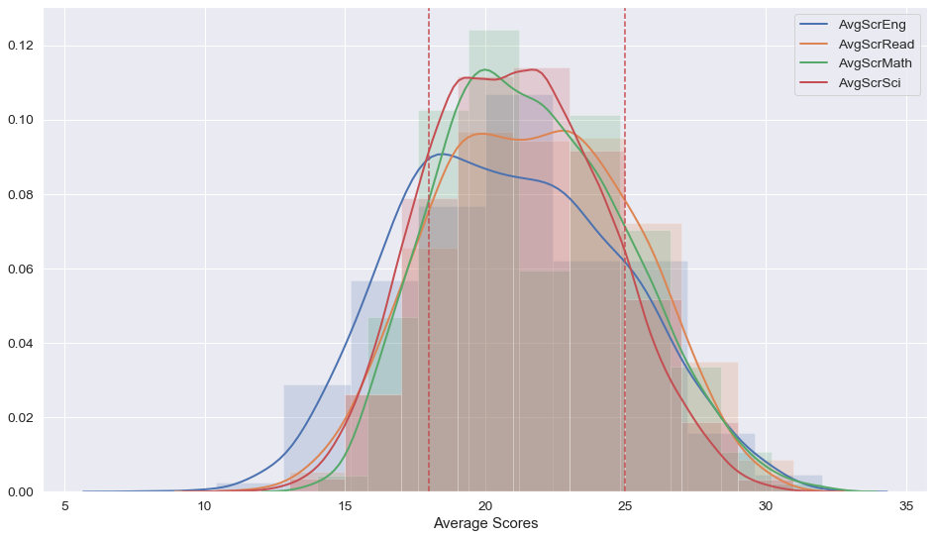
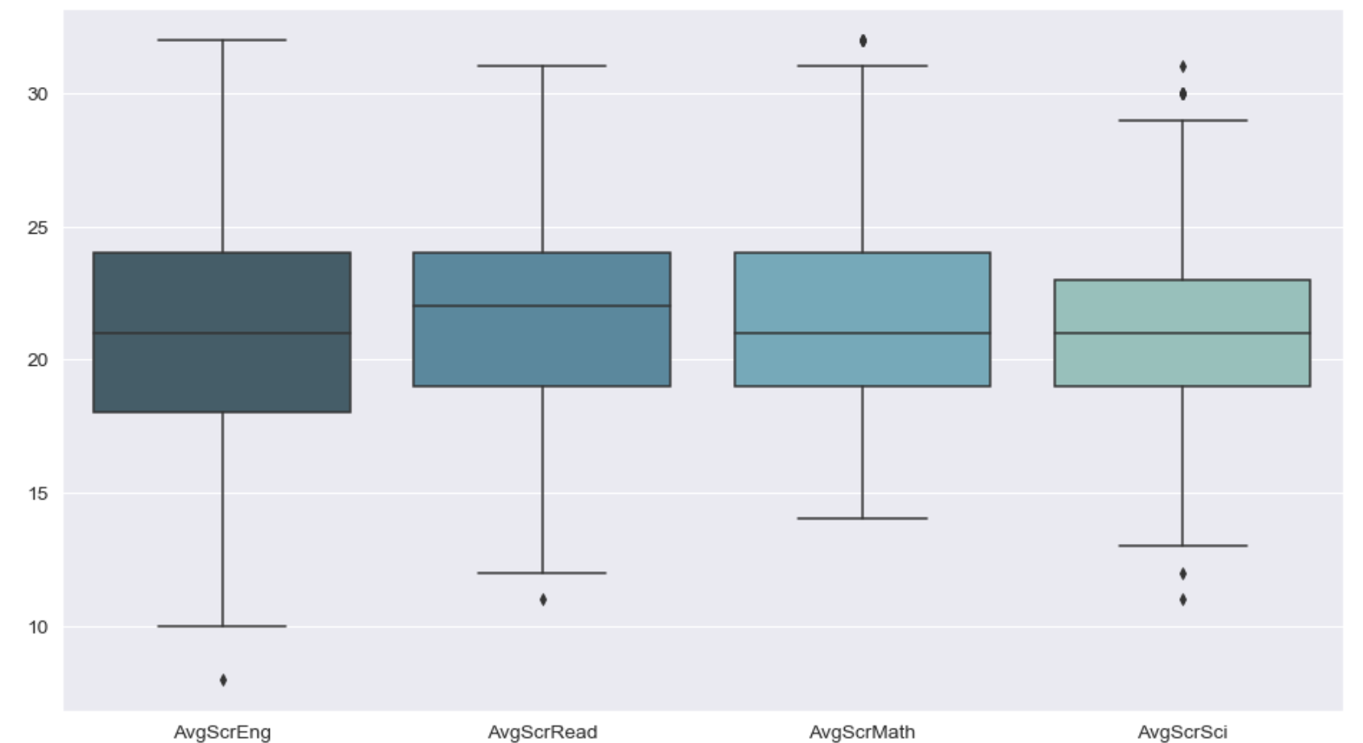
On which subjects are the schools performing better?
The schools in the high score range (>=25) perform worse on the Science section.
The schools in the low score range (≤18) perform better in English.
The schools in the middle score range (18-25) perform better on the Math and Science sections, worse in English.
About 60% of the schools received about 22 or less in English, and about 40% of the schools received 22.0 or more in Science.

Slide 9
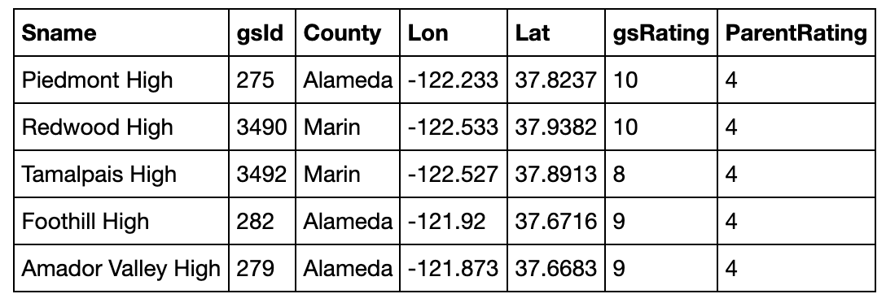
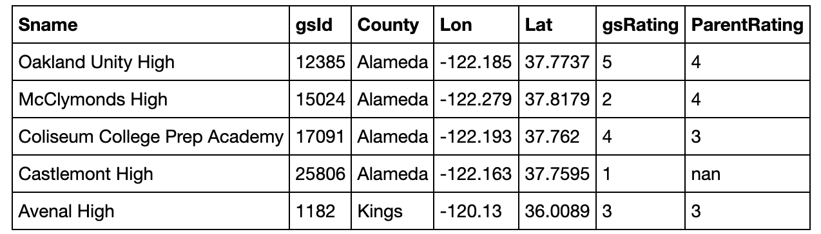
Which schools received the highest and lowest ACT scores?
These are the schools which received 28.0 or higher which is the top 2.5% of the overall average Act scores
These are the schools which received 15.25 or lower which is 2.5% of the average scores

Slide 10
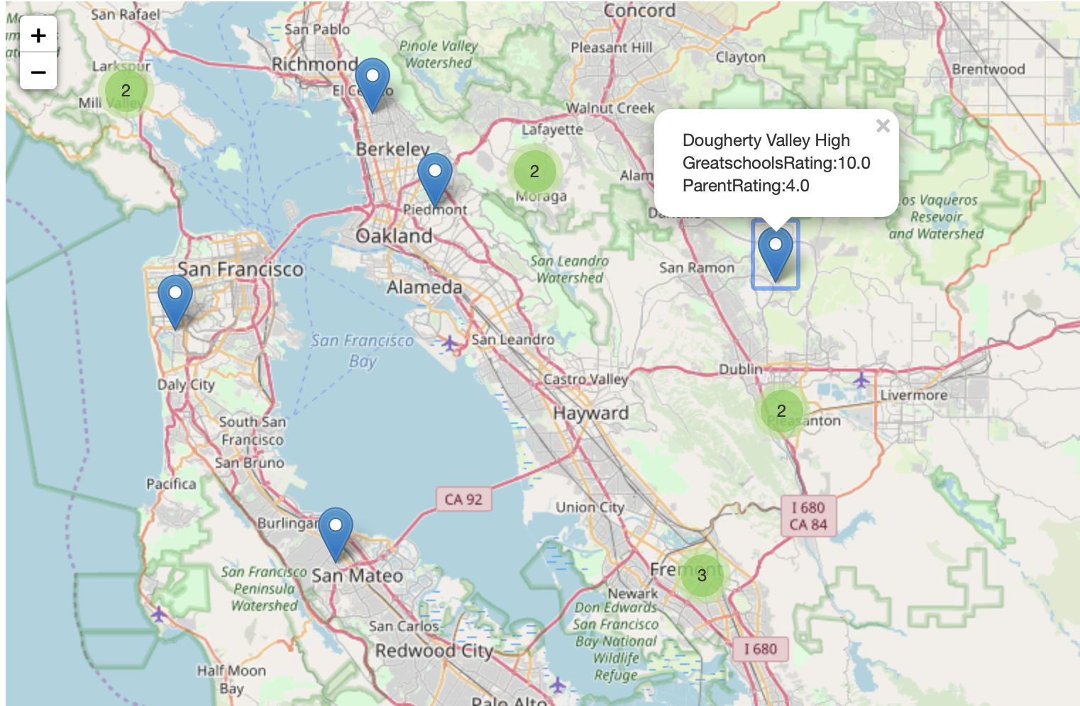
Which counties have the highest and lowest performing schools?
The highest performing schools were in the following counties:
Santa Cruz,
Alameda,
Contra Costa,
Marin,
Sacramento,
San Francisco,
San Diego,
Orange,
San Mateo,
Santa Clara,
Los Angeles,
Nevada.

Slide 11
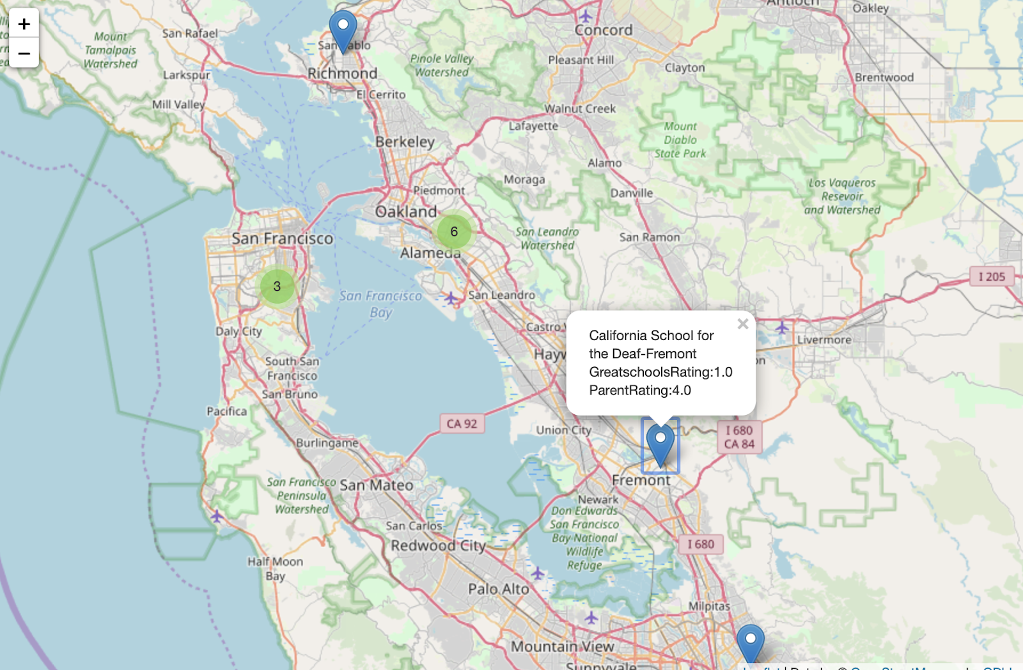
Which counties have the highest and lowest performing schools?
The lowest performing schools were in the following counties:
San Joaquin,
Santa Clara,
Kings,
Alameda,
Contra Costa,
Tulare,
Riverside,
Fresno,
Sacramento,
San Francisco,
San Diego,
San Bernardino,
Los Angeles.

Slide 12
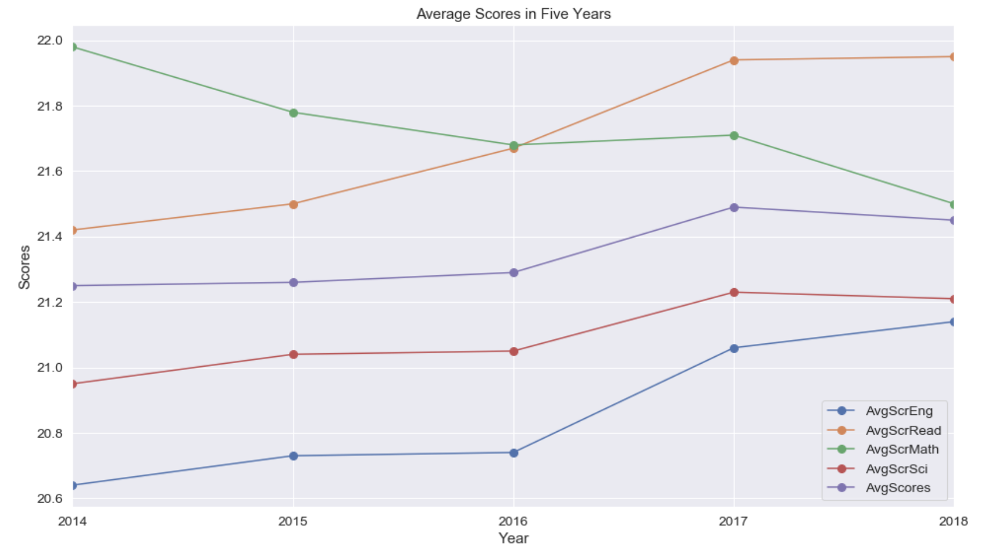
Is there an increase of the success level of schools with time?
Average Scores in Five Years
While average Reading, English and Science scores are increasing in five years, average Math scores are decreasing. On the other hand, overall scores are also increasing.

Slide 13
What kind of factors influence success levels?
Ethnicity
Number of low-income students
New teacher ratios
Population of the schools

Slide 14
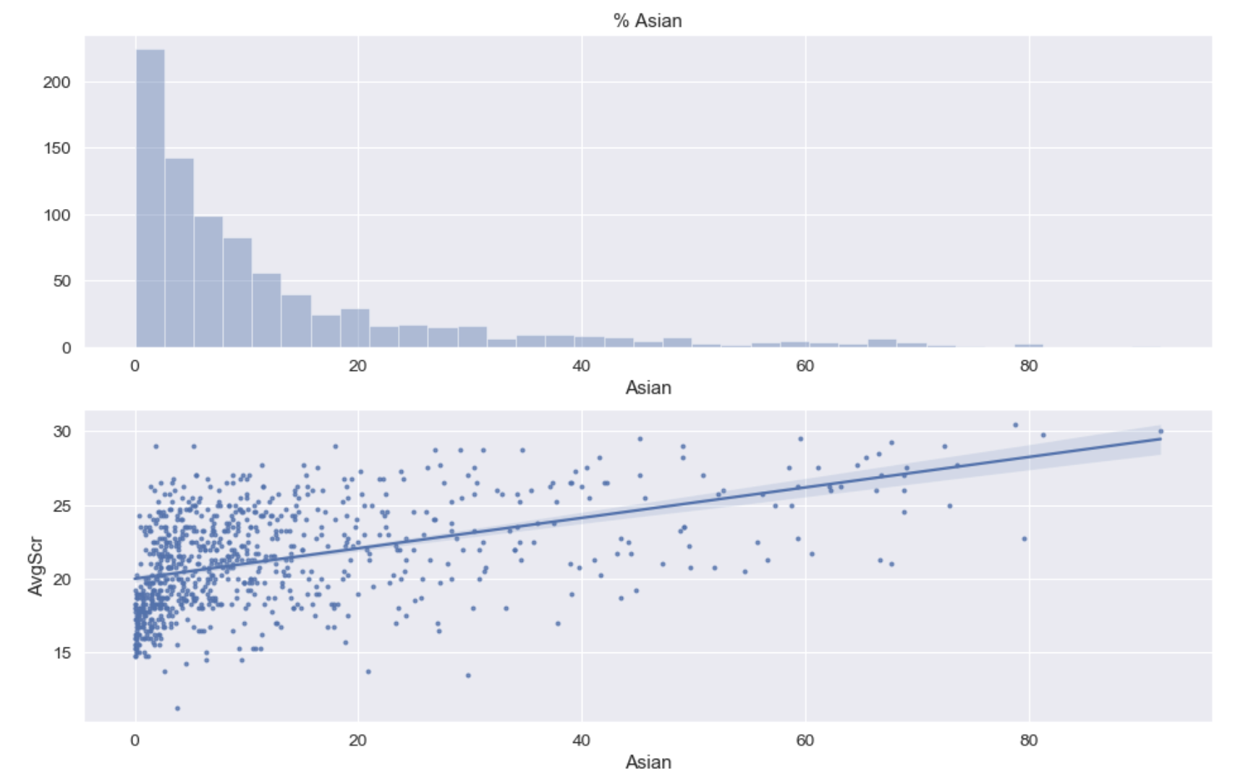
% of Asian Students
Number of schools
Percentage of students

Slide 15
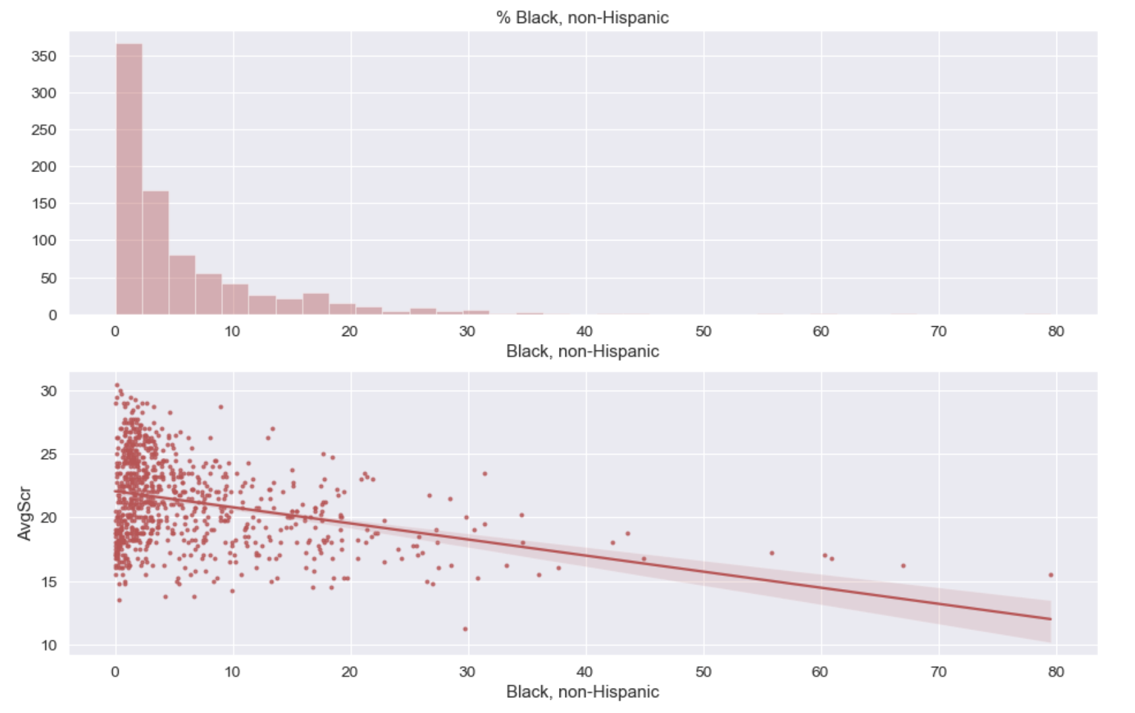
% of Black, Non-Hispanic Students
Number of schools
Percentage of students

Slide 16
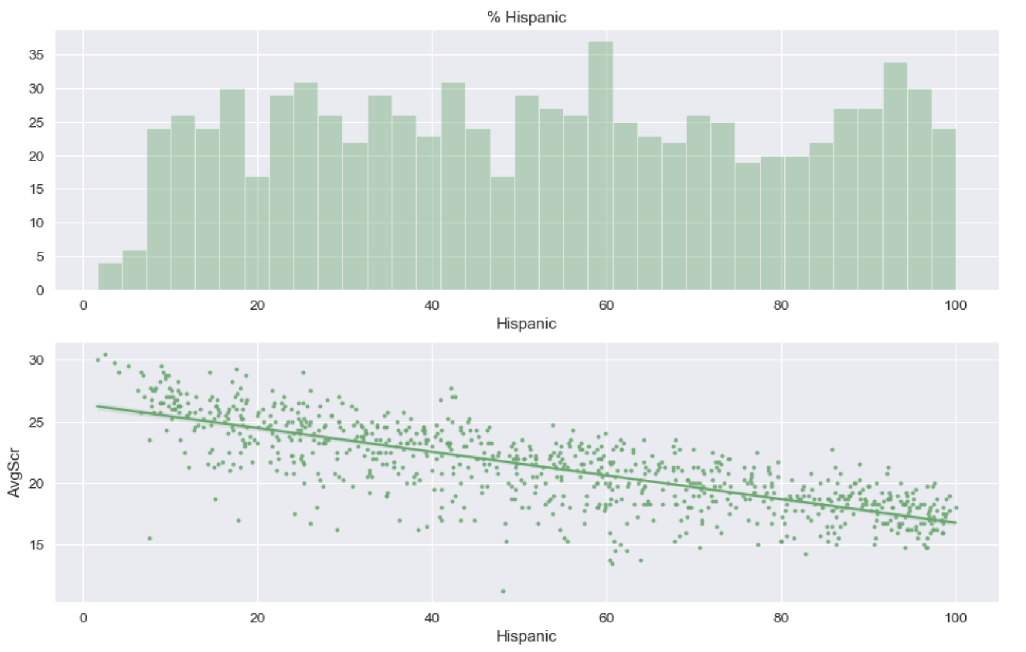
% of Hispanic Students
Number of schools
Percentage of students

Slide 17
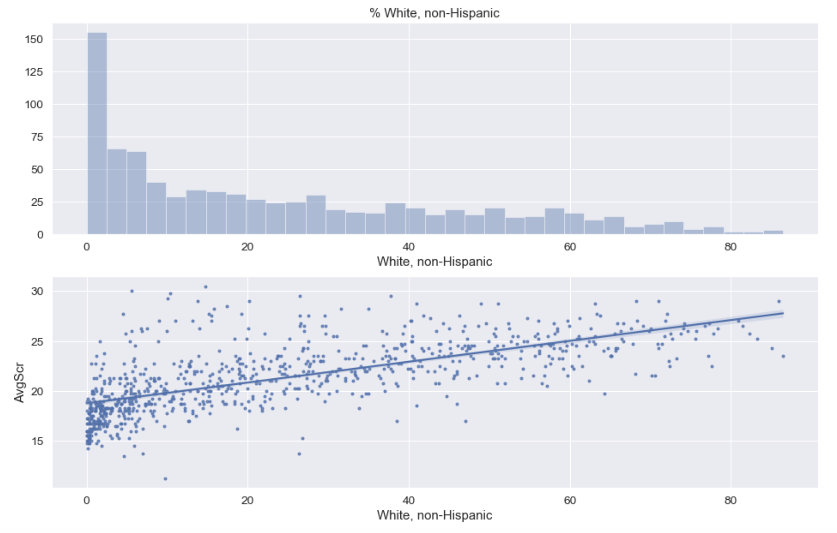
% of White, Non-Hispanic Students
Number of schools
Percentage of students

Slide 18
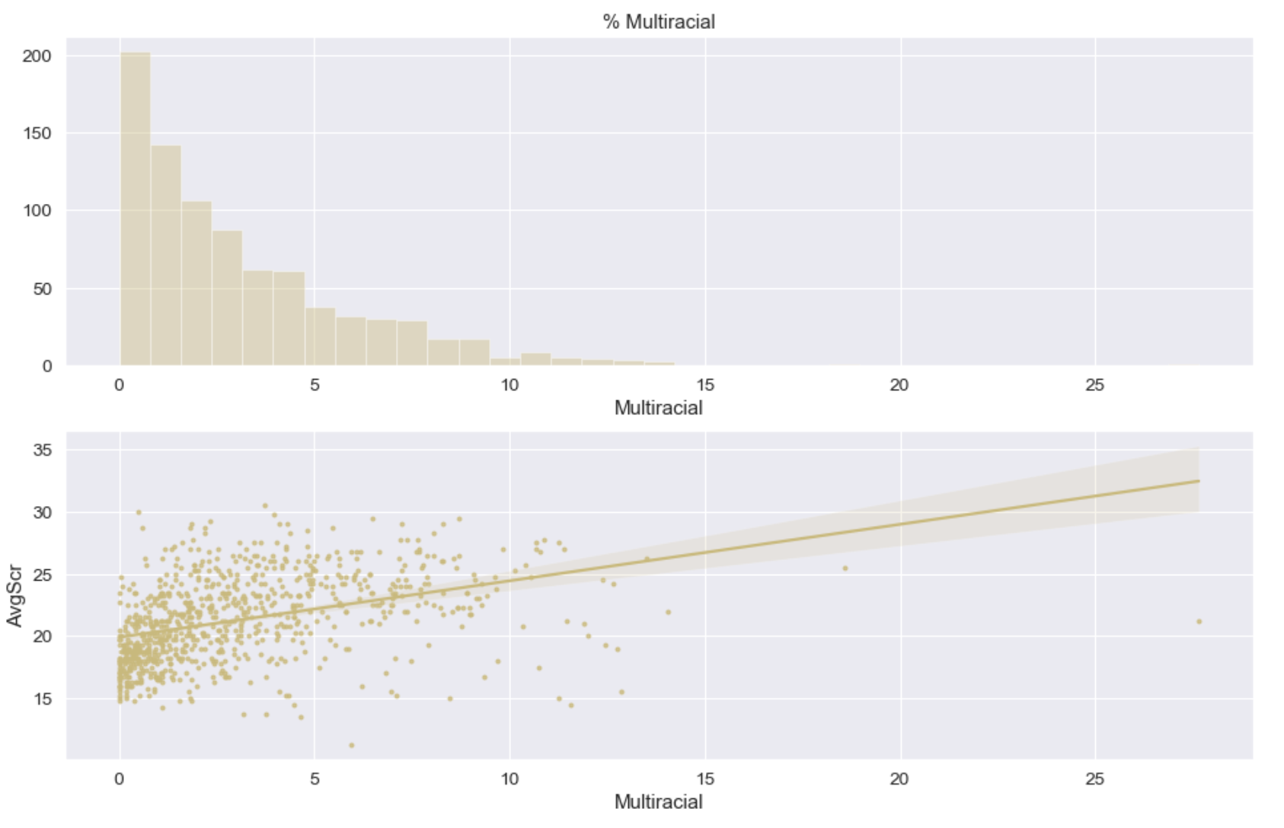
% of Multiracial Students
Number of schools
Percentage of students

Slide 19
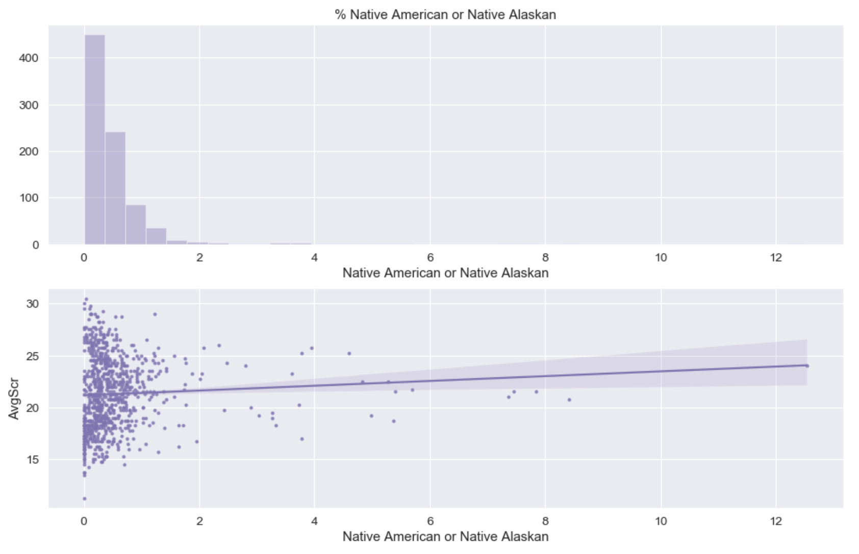
% of Native American or Native Alaskan Students
Number of schools
Percentage of students

Slide 20
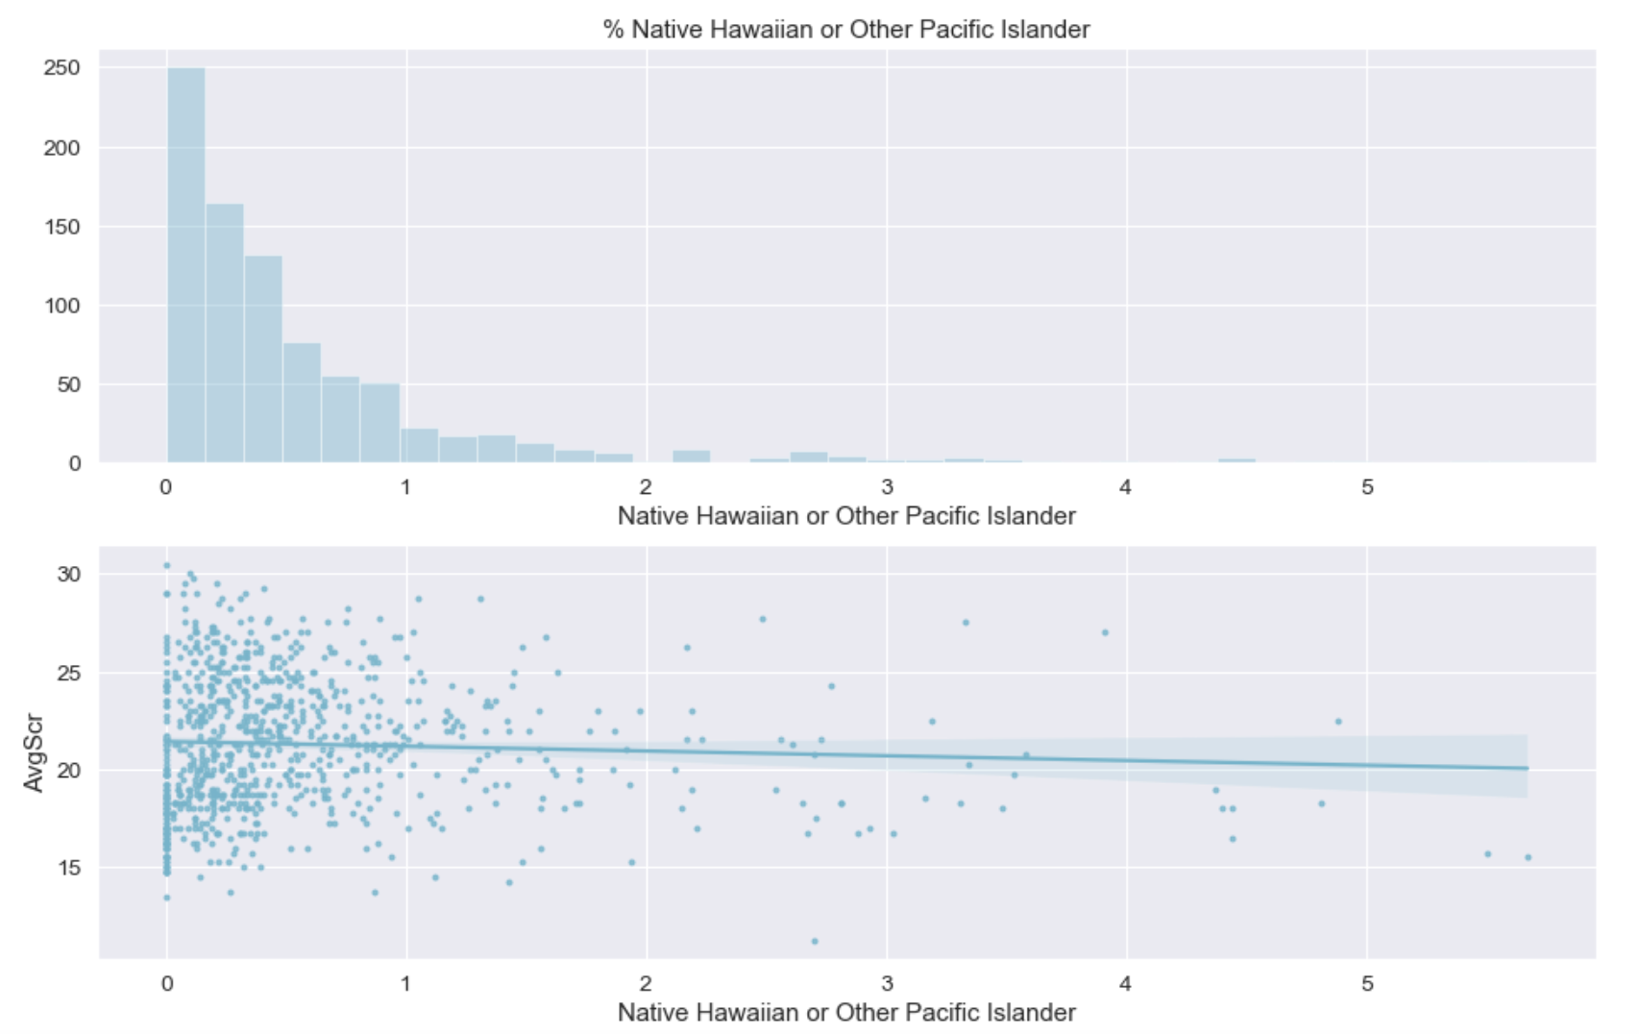
% of Native Hawaiian or Pacific Islander Students
Number of schools
Percentage of students

Slide 21
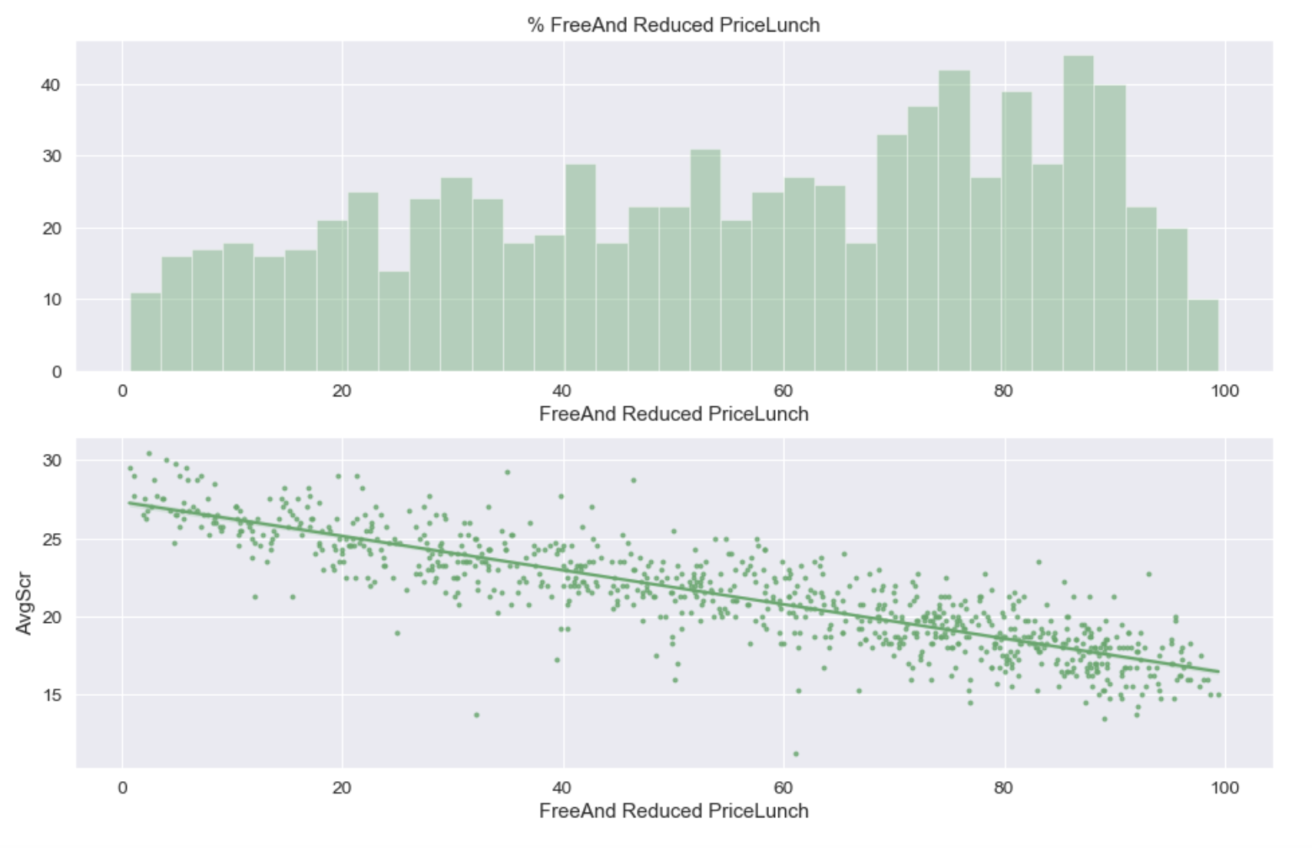
% of Low-Income Students
Number of schools
Percentage of students

Slide 22
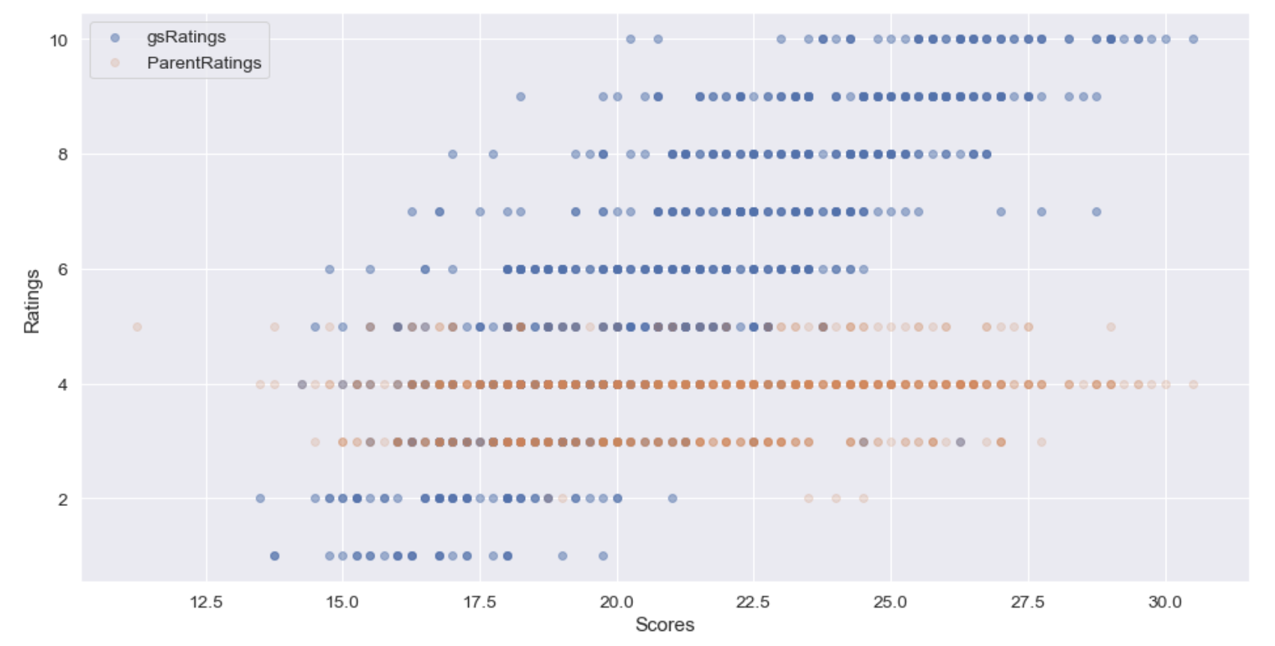
Are the ratings related to school success?
Positive linear relationship between the greatschools.org ratings and the ACT scores
No correlation between the parent ratings and the success level of a school

Slide 23
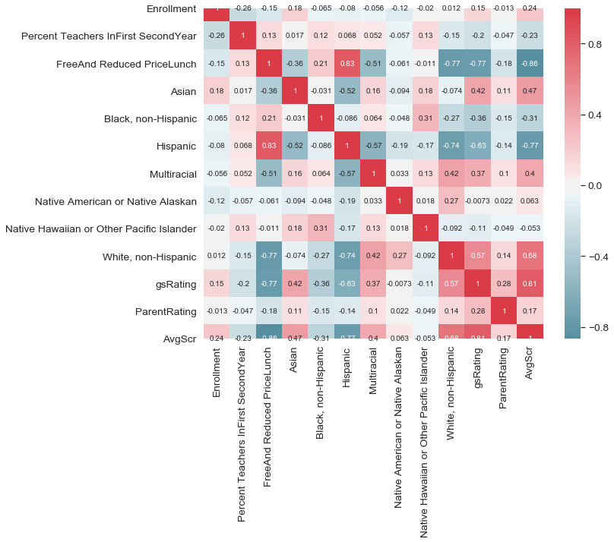

Correlation Matrix
Red color represents the positive correlation and green color represents the negative correlation between the variables

Slide 24
Machine Learning Analysis
Unsupervised Learning
Supervised Learning

Slide 25
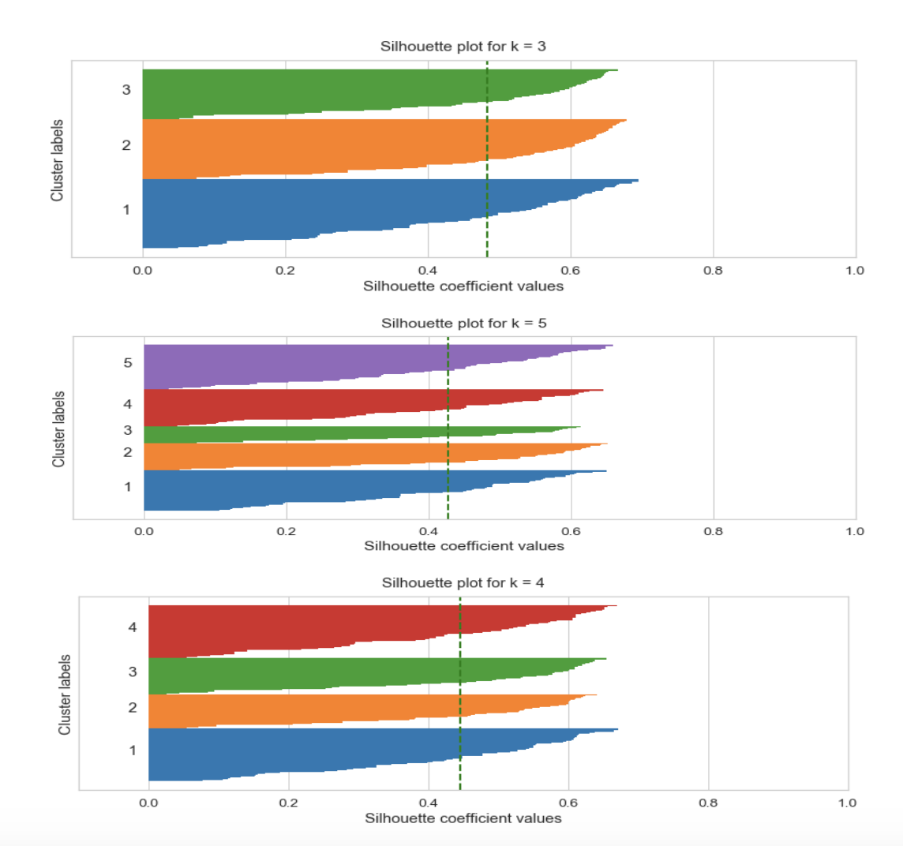
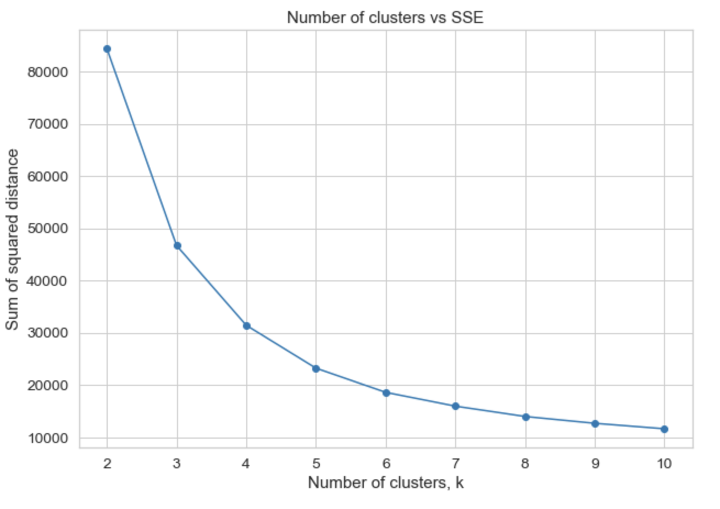
Unsupervised Learning
K-means clustering is applied using only the ACT scores
Silhouette Analysis
Elbow Method
Best number of clusters k =3.

Slide 26
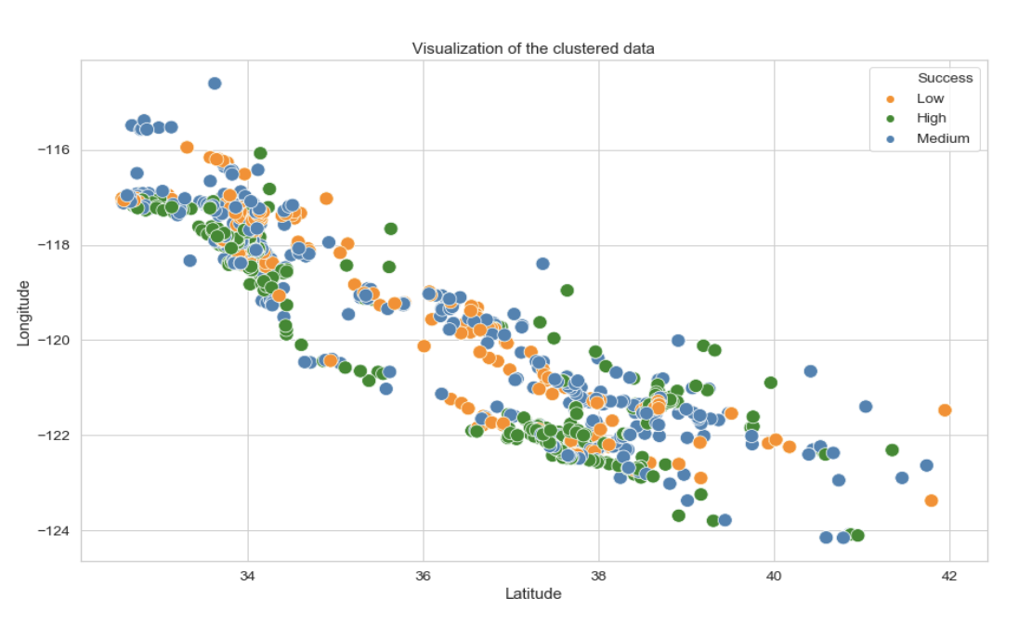
Visualization of clustered data
Success Levels
Low
Medium
High

Slide 27
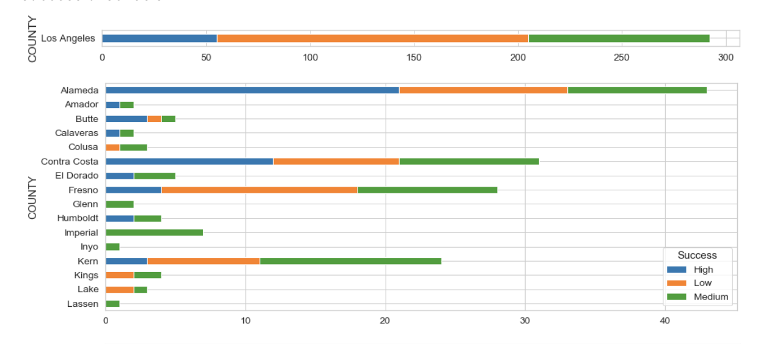
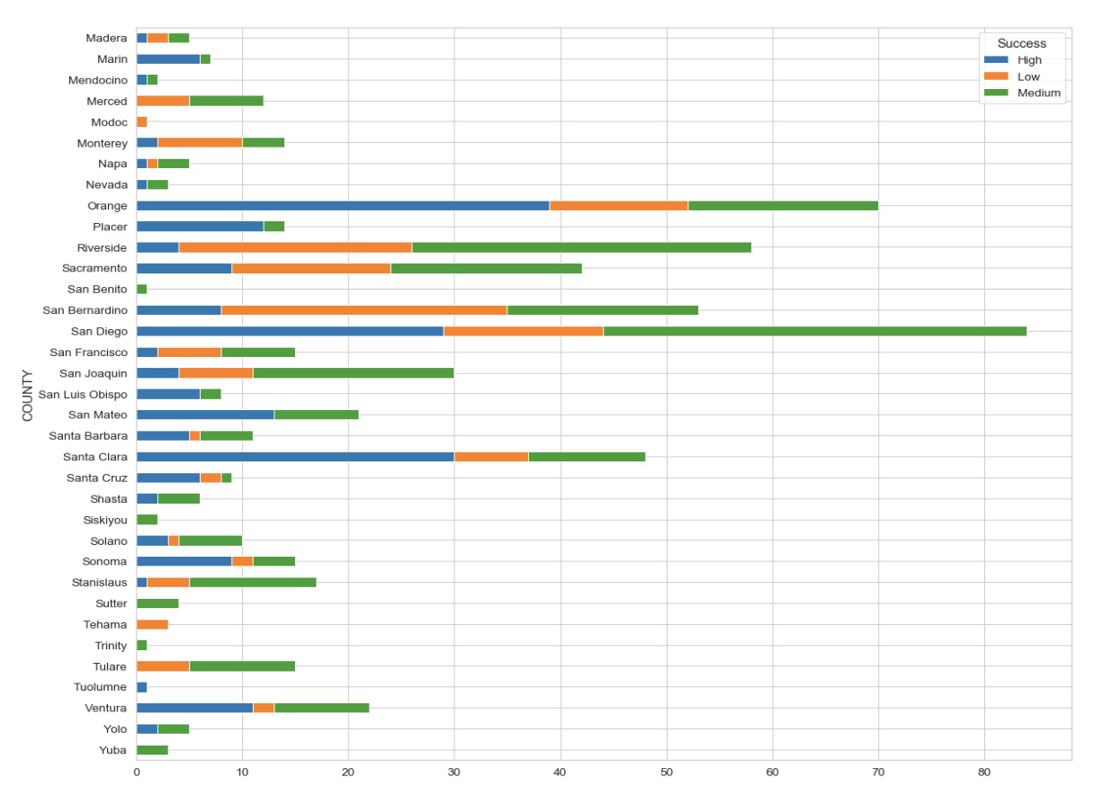

Visualization of clustered data
Success Levels
Low
Medium
High
Success levels of high schools in each county
Schools with high percentage of orange color means that they contain more schools with low success

Slide 28
Supervised Learning
The aim of this section is predicting the success level of a high school based on
the percentage of the students who come from different ethnic backgrounds,
the percentage of students who receive reduced and free meals,
whether a school is public or charter.

Slide 29
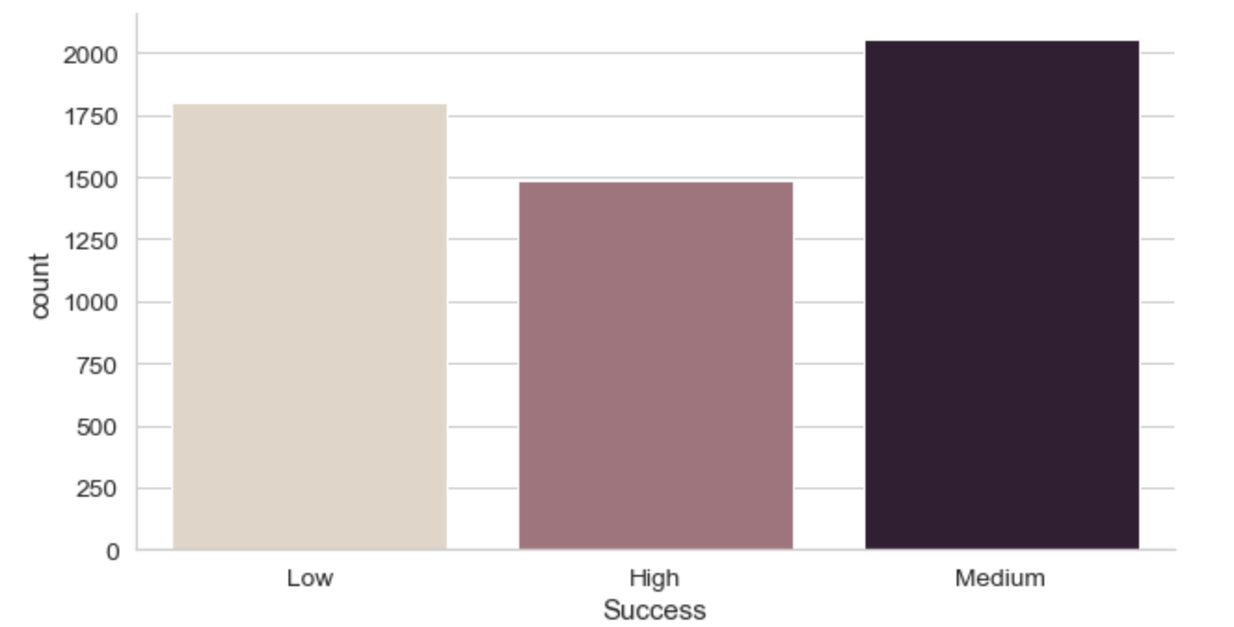
Supervised Learning - Data Preparation
Train set - Data from 2014 to 2017
Test set – Data from 2018
%80 to %20 split
Number of schools in each class
Used SMOTE technique to balance the number of schools in each class.

Slide 30
Supervised Learning
Used algorithms for multiclass problem:
Algorithm | Accuracy on train set | Accuracy on test set
Logistic Regression | 0.7694 | 0.7483
KNeighbors Classifier | 0.7978 | 0.7717
Decision Tree Classifier | 0.7899 | 0.7467
Voting | 0.7972 | 0.7717
Bagging | 0.7645 | 0.7372
Random Forest Classifier | 0.8096 | 0.7629
XGBoosting | 0.8173 | 0.7661

Slide 31
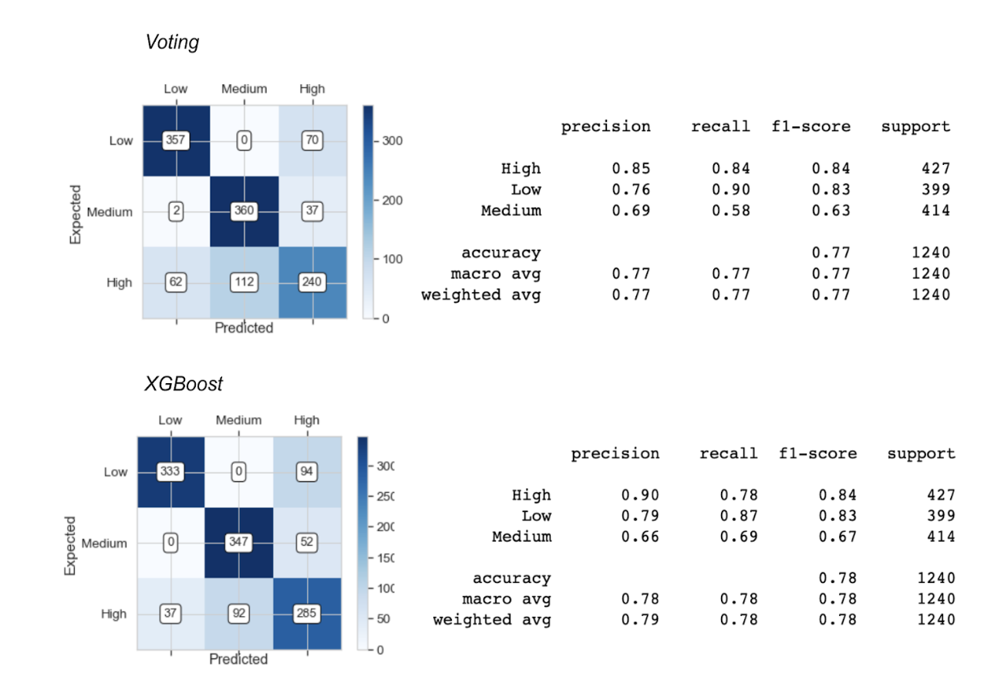
Supervised Learning
Best performing models:

Slide 32
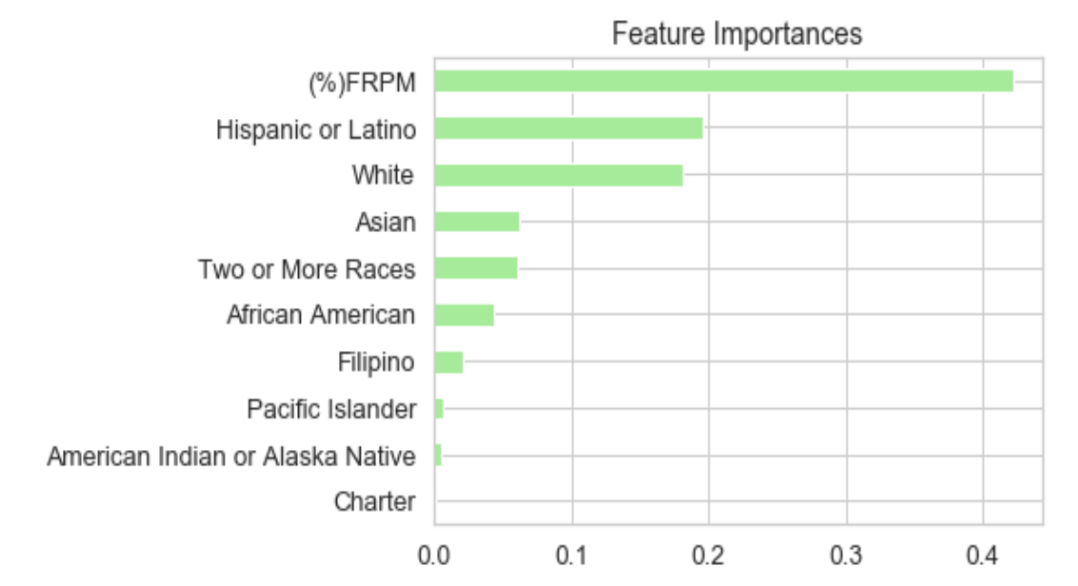
Supervised Learning

Slide 33
Thank you!
Meral Balik
E-mail : tekmer@hotmail.com
Linkedin : www.linkedin.com/in/meralbalik
Project @ https://github.com/Meralbalik/Capstone-Project-1

